Slide 1

data.table
New Developments
Tyson S. Barrett
rfinance(2024L)
Notes:
Image by DALL-E

Slide 2
Who Am I?
Current "maintainer" of data.table (more on this at the end!)
PhD in Quantitative Psychology (Bachelor’s in Economics)
data.table user since 2016, contributor since 2019
Author/maintainer of 6 other R packages (3 on CRAN)
Currently managing a team of researchers at Highmark Health (lots of big data wrangling and cleaning)
CEO of Barrett Evaluation, LLC (big talk for I consult on projects with big data)
rfinance(2024L)

Slide 3

“dplyr will be the death of data.table ”
An attendee said to Matt Dowle (creator of data.table) at an R Finance Conference a decade ago
rfinance(2024L)
Notes:
No arguing that the tidyverse changed the way R (and several other languages) think about syntax and data
But it isn’t the tool for everything all the time
I’ll use examples from the tidyverse so we have a shared language here

Slide 4
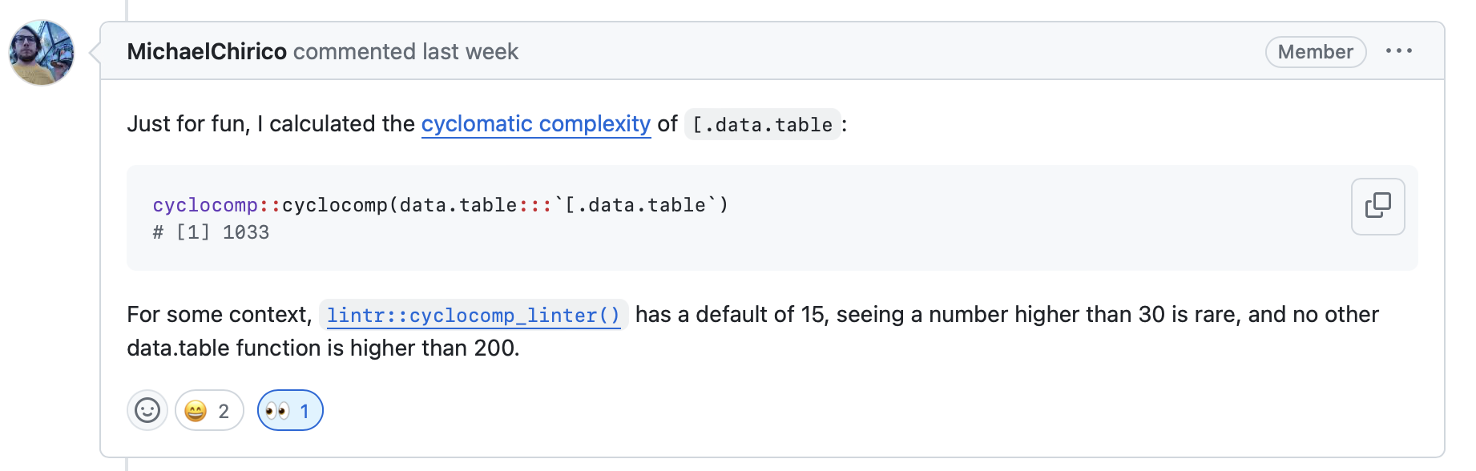
data.table is complex!
rfinance(2024L)
Notes:
The package is complex and no person knows the whole things, but together we just might know the whole thing

Slide 5

Agenda
Why (still) use data.table ?
New developments!
New “management”
New features
New ways to engage
rfinance(2024L)

Slide 6
data.table
Why
?
But there’s new tools, why not use those??
Matt’s useR talk from 2014 https://youtu.be/qLrdYhizEMg?t=1m54s
rfinance(2024L)
Notes:
Why data.table? Here’s a few as listed on the data.table README file.

Slide 7
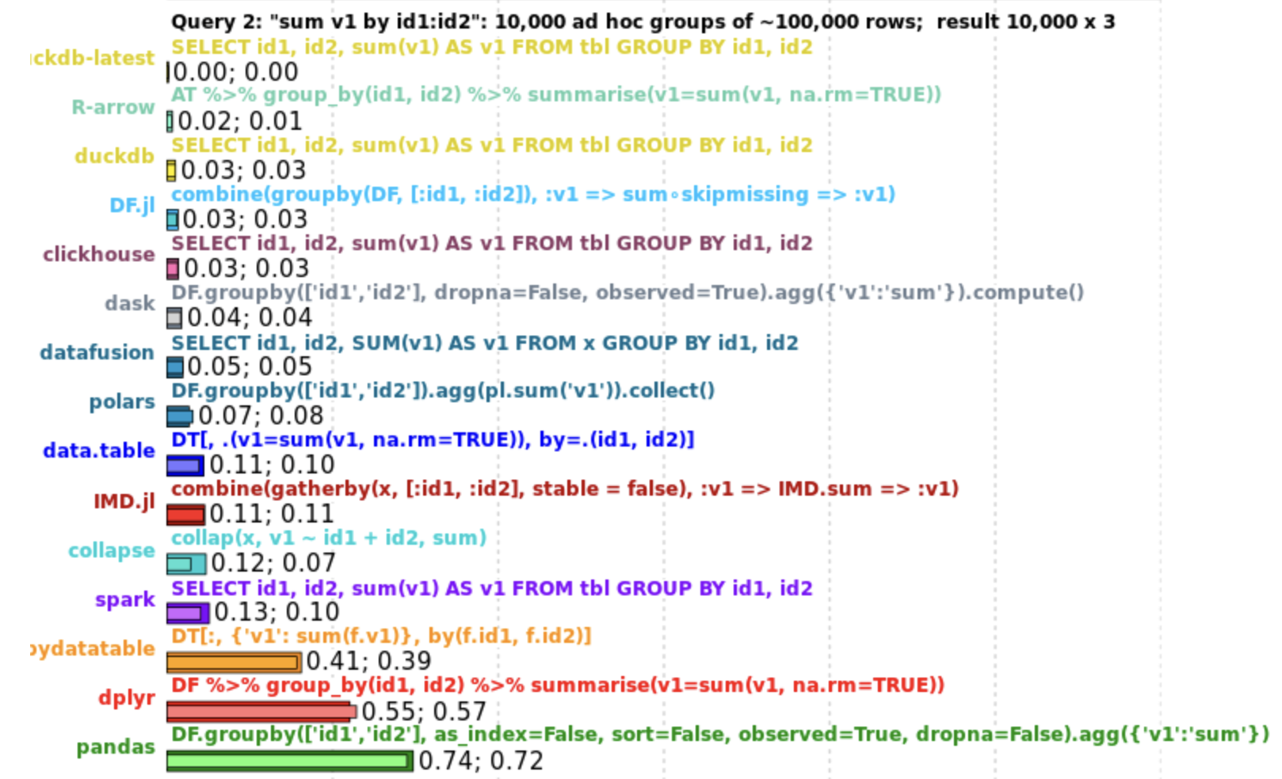
data.table
Why
?
But there’s new tools, why not use those??
Matt’s useR talk from 2014 https://youtu.be/qLrdYhizEMg?t=1m54s
rfinance(2024L)
Notes:
Why data.table? Here’s a few as listed on the data.table README file.

Slide 8
data.table
Why
?
Concise syntax
data.table has more features than many of these
(it can interact with data with all of the tools in R, including custom functions)
https://duckdblabs.github.io/db-benchmark/
Fast speed
It’s consistently one of the top performing, even with major investments in tools like DuckDB and Polars
data.table has more features than many of these: it can interact with data since you still have all of the tools in R to work with
Memory efficient
Careful API lifecycle management
Community
Feature rich
rfinance(2024L)
Notes:
Finally it is super memory efficient. Data sets that shut down other systems work in data.table. This table shows how different systems handled a data set with 1 billion rows and 9 columns.

Slide 9
data.table
Why
?
Concise syntax
Fast speed
Memory efficient
Careful API lifecycle management
Community
Feature rich
Matt’s useR talk from 2014 https://youtu.be/qLrdYhizEMg?t=1m54s
rfinance(2024L)
Notes:
Why data.table? Here’s a few as listed on the data.table README file.

Slide 10
data.table
Why
?
dt[i, j, by]
Concise syntax
Fast speed
Memory efficient
dt[grp == “treatment”, new := mean(x), by = id]
Careful API lifecycle management
dt[dt2, on = “id”]
Community
dt[dt2, on = “id”, roll = TRUE] # rolling joins!
Feature rich
dt[, .N, by = id]
Matt’s useR talk from 2014 https://youtu.be/qLrdYhizEMg?t=1m54s
rfinance(2024L)
Notes:
Why data.table? Here’s a few as listed on the data.table README file.

Slide 11
data.table
Why
?
Concise syntax
Fast speed
Thoughtful and careful so there are very few breaking changes
Can be used in production code safely
Memory efficient
Careful API lifecycle management
Community
Feature rich
Matt’s useR talk from 2014 https://youtu.be/qLrdYhizEMg?t=1m54s
rfinance(2024L)
Notes:
Why data.table? Here’s a few as listed on the data.table README file.

Slide 12
data.table
Why
?
Concise syntax
Fast speed
Memory efficient
Careful API lifecycle management
Community
More on this in a moment!
Feature rich
Matt’s useR talk from 2014 https://youtu.be/qLrdYhizEMg?t=1m54s
rfinance(2024L)
Notes:
Why data.table? Here’s a few as listed on the data.table README file.

Slide 13
data.table
Why
?
Concise syntax
Fast speed
Memory efficient
Careful API lifecycle management
Community
Power of all of R + Gforce + grouped optimization (more on this later!)
Feature rich
Matt’s useR talk from 2014 https://youtu.be/qLrdYhizEMg?t=1m54s
rfinance(2024L)
Notes:
Why data.table? Here’s a few as listed on the data.table README file.

Slide 14
New Developments!
Grant from NSF (PI = Toby Hocking) to create new governance and support its development (NSF POSE program, project #2303612)
Re-invigorated development and new features
Ways to engage in development
rfinance(2024L)
Notes:
Where I want to focus this talk

Slide 15
New Developments!
Grant from NSF (PI = Toby Hocking) to create new governance and support its development (NSF POSE program, project #2303612)
https://github.com/Rdatatable/data.table/blob/master/GOVERNANCE.md
rfinance(2024L)
Notes:
Go to README to show Roles and Decisions

Slide 16
New Developments!
A semi-democratic approach to dev
Can become any role in data.table by submitting PR and votes from the community (and no strong pushback)
Can help shape the development of the package
One aspect of the governance is the “what is possible for development” which can be updated
Grant from NSF (PI = Toby Hocking) to create new governance and support its development (NSF POSE program, project #2303612)
https://github.com/Rdatatable/data.table/blob/master/GOVERNANCE.md
rfinance(2024L)

Slide 17
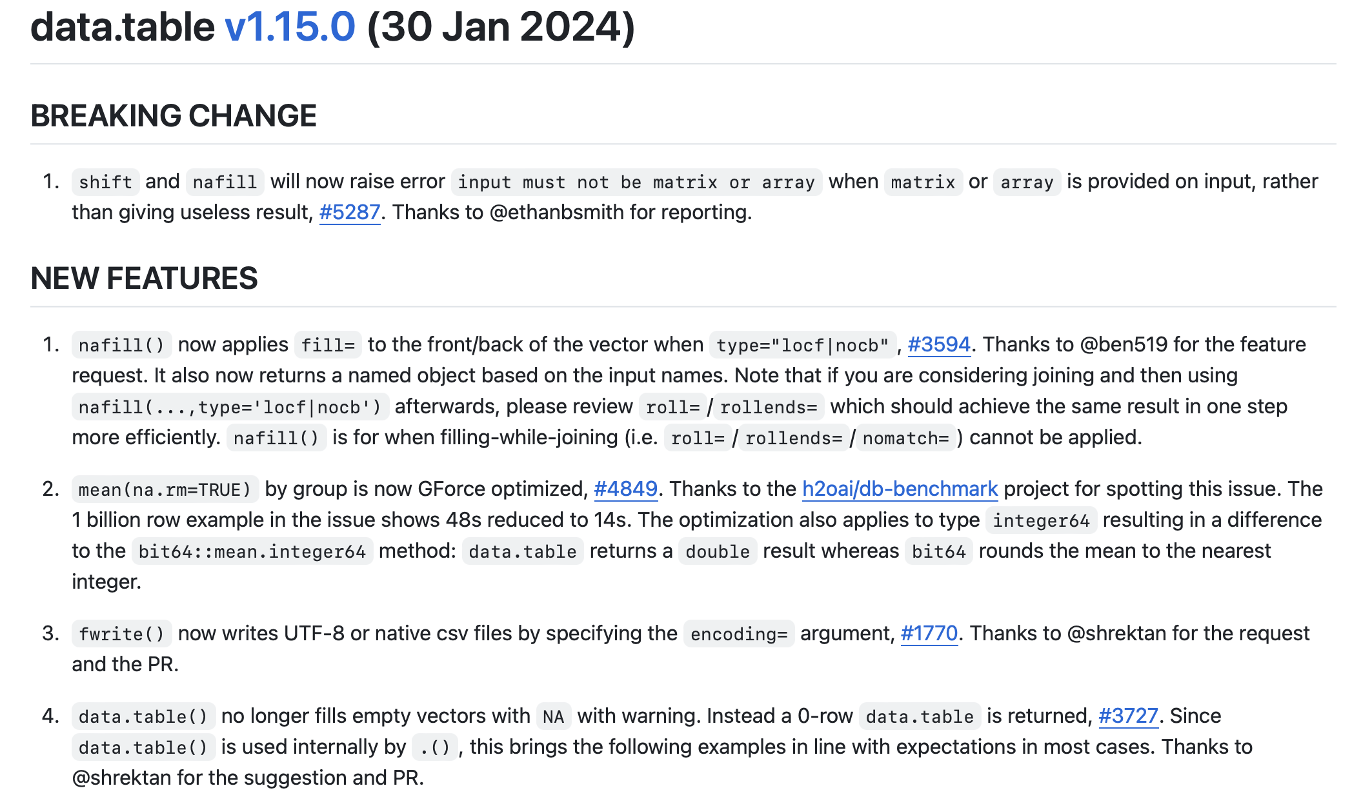
New Developments!
Re-invigorated development and new features
41 new features!
And several fixes and speed ups
rfinance(2024L)

Slide 18
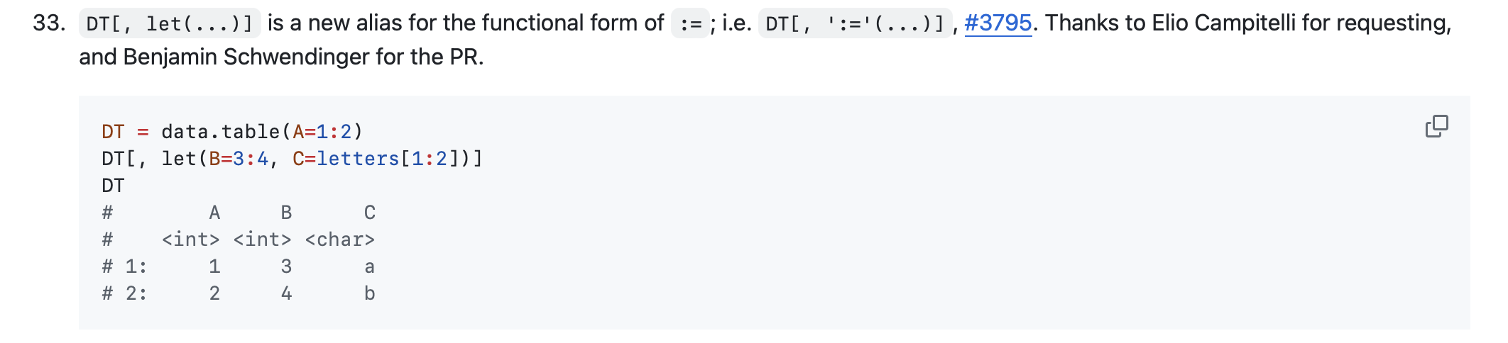
New Developments!
Re-invigorated development and new features
rfinance(2024L)
Notes:
Some of my favorite new features

Slide 19
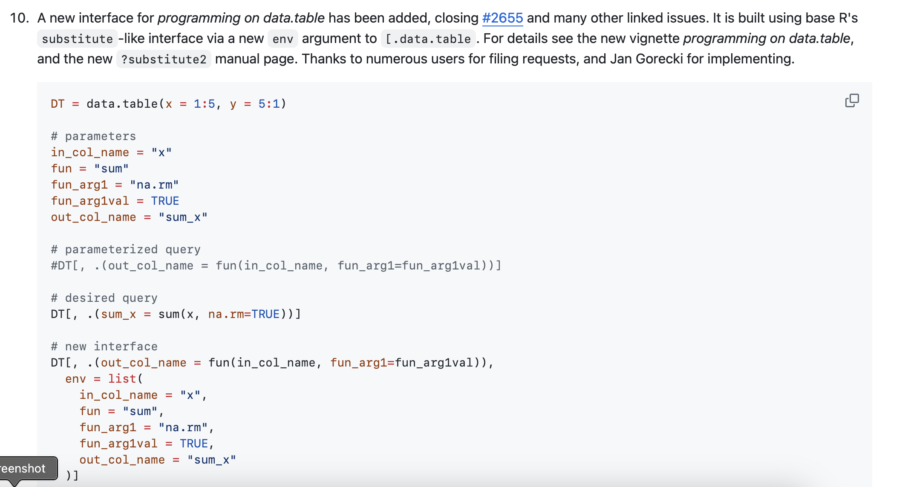
New Developments!
Re-invigorated development and new features
rfinance(2024L)
Notes:
Some of my favorite new features

Slide 20
New Developments!
Re-invigorated development and new features
This is important because of non-standard evaluation
R needs to be told if this is an object or something it should look for inside of another object
rfinance(2024L)
Notes:
Some of my favorite new features

Slide 21
New Developments!
Re-invigorated development and new features
library(data.table)
DT = data.table(x = 1:5, y = 5:1)
custom = function(dt, var_name, mutate){
dt[, (var_name) := mutate]
dt
}
custom(DT, "thing", x+y) # ERROR
custom2 = function(dt, var_name, mutate){
dt[, (var_name) := mutate,
env = list(mutate = substitute(mutate))]
dt
}
custom2(DT, "thing", x+y) # works!
> DT
x y thing
<int> <int> <int>
1: 1 5 6
2: 2 4 6
3: 3 3 6
4: 4 2 6
5: 5 1 6
rfinance(2024L)
Notes:
Some of my favorite new features

Slide 22
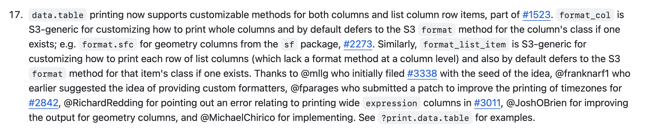
New Developments!
Re-invigorated development and new features
rfinance(2024L)
Notes:
Some of my favorite new features

Slide 23
New Developments!
Ways to engage in development
1
GitHub Issue Tracker
New pull request testing that assesses speed regressions (or benefits) from a new pull request!
rfinance(2024L)

Slide 24
New Developments!
Ways to engage in development
2
“Seal of Approval”
https://github.com/Rdatatable/data.table/issues/5723
rfinance(2024L)

Slide 25
New Developments!
Ways to engage in development
3
Vote on GitHub Pull Requests
rfinance(2024L)

Slide 26
New Developments!
Ways to engage in development
4
Talk, publish about it
rfinance(2024L)
Notes:
Writing blogs and examples of how you use it helps build a community

Slide 27





Tyson S. Barrett
Thanks to Matt Dowle and Arun Srinivasan and the data.table team!
t.barrett88@gmail.com
tysonbarrett.com
@healthandstats
github.com/tysonstanley
Slides at tysonbarrett.com/teaching
rfinance(2024L)

